Slide 1
Integrative bioinformatic analysis of SARs-CoV-2 data
Mirela Bãlan
Supervisor: Prof. Jan Komorowski
Co-supervisor: Dr. Fredrik Barrenäs

Slide 2
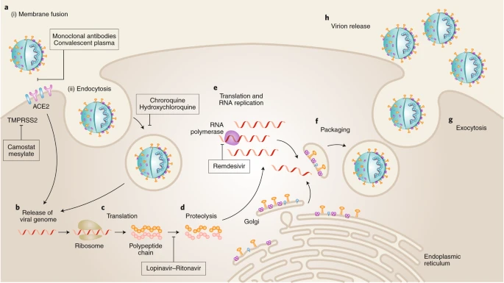
Background for SARS-CoV-2 infection
COVID-19 is caused by SARS-CoV-2 virus
uses the ACE2 as cell entry receptor
different transmission routes, pathogenic mechanisms, immunity development
broad range of symptoms and disease trajectories
initial symptoms: headache, fever, cough, shortness of breath
no correlation between severity and disease development
strong inflammatory responses:
all outcomes: ↑ IL-1α, IL-1β, IL-17A, IL-12 p70, IFNα
severe disease: ↑ IL-1b, IL-6, TNF ~ cytokine release syndrome
+ thrombopoietin, IL-33, IL-16, IL-21, IL-23, IFNλ, eotaxin
+ increase in inflammatory monocytes and neutrophils
+ sharp decrease in leukocytes
Florindo, 2020, Nat Nanotechnol

Slide 3
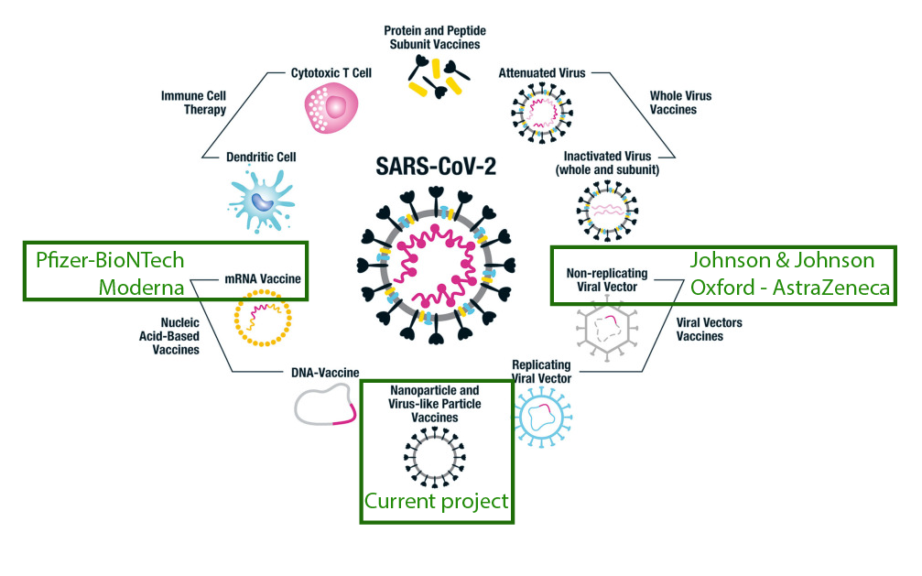
Types of vaccination
- traditionally: deliver live, weakened, inactivated pathogens or immunogenic parts
- new: delivery with a virus-derived replicon RNA system:
- open reading frame of a viral RNA polymerase complex
- an antigen-encoding gene from the pathogen.
Florindo, 2020, Nat Nanotechnol

Slide 4
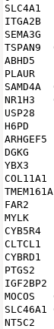
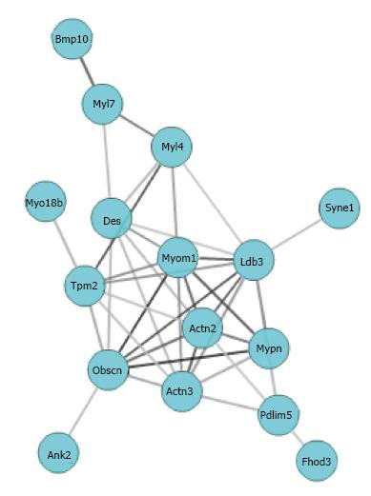
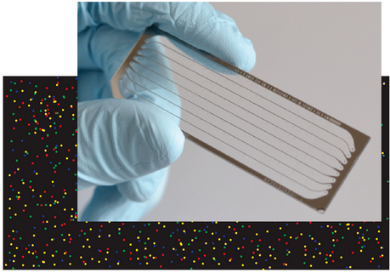
Introduction to methodology
Prior knowledge about cellular processes and pathways
Ranking or
clustering
Analysis
tools
Insight
High-throughput experiment
DE gene list
Griffith, 2015, PloS Comput Biol
Gu, 2017, World J Cardiol.

Slide 5
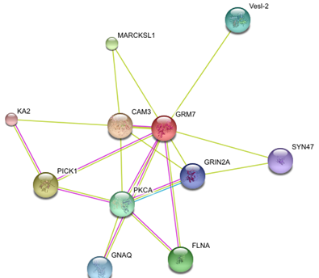
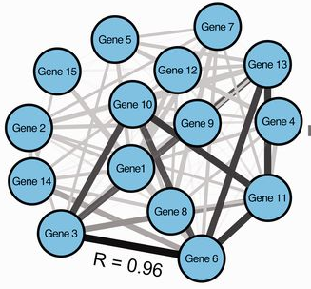
Current methods to make interaction networks
Prior knowledge about cellular processes and pathways
Protein-protein interaction network
- mapped physical protein-protein interaction (determined experimentally)
Limited:
literature based
biased by current knowledge
Experimental limited by quality of experiments:
Yeast-2-hybrid
Mass-spectrometry
Co-expression networks
- id the tissues and the conditions in which important interactions occur; statistical inference
False positive interactions
Low resolution in dense gene clusters
Limited by available data

Slide 6
DINA overcomes limitations by big data approaches
Scarce or absent knowledge about cellular processes and pathways
Dynamic Integrated Network Analysis
Conserved interactions
(across tissues, conditions, species)
are more likely to be
biologically relevant
Data from:
mammals
single tissue
various diseases
lung
Observations from model organisms don’t always translate to human biology
Fetal lung development
Smoking/COPD
Particle inhalation/fibrosis
Asthma/pulmonary hypertension
Allergen
Infectious diseases
SARS-CoV
MERS-CoV
Marcotte et al; Lee et al

Slide 7
Creating DINA
An automated pipeline +
Two manual components:
Microarray annotation (ID > hu Ensembl Gene ID)
Annotated gene expression data file
Gene expression data processing
Very high variation between ”raw data” in GEO.
“Raw” microarray data can be raw, log transformed, normalized
RNAseq data can be given as raw counts, normalized counts, FPKMs, CPMs etc.
Aggressive rank normalization for microarray data
RNAseq data transformed to CPMs, if given as raw counts.

Slide 8
Gene-gene interactions are identified in each dataset separately
Any gene interaction metric can be applied
In this case: biweight midcorrelation (bicor)

Slide 9
Integration of public domain datasets to support bioinformatic analysis
GEO
Transcriptomic profiles
Public datasets
Correlation
matrices
Collapse to single matrix
T-test
Each gene pair evaluated based on over 80 datasets

Slide 10
Integration of public domain datasets to support bioinformatic analysis
$Σ$
Each gene is connected to top 3 correlators
Calculate all gene-gene distances in network
Average linkage hierarchical clustering
Biological modules by dynamic tree cut
Correlation scores filtered – non-conserved correlations penalized
Added statistical robustness
The end of each branch corresponds to a module
The closer modules are located in the network, the lower branches connect them
Dendrogram can also be viewed from “above” as a tree-and-leaf network

Slide 11
Each network branch associated with specific biological processes
18023 genes
47196 unique interactions
Cellular morphology
Dendrite development
Protein
modification
T and B cell activation
rRNA processing
Respiratory
tissue
development
Innate, interferon
mediated immunity
Lung development
Vascularization
Neuronal development
and signaling
Mitochondrial
respiration
Cilium transport
and movement

Slide 12
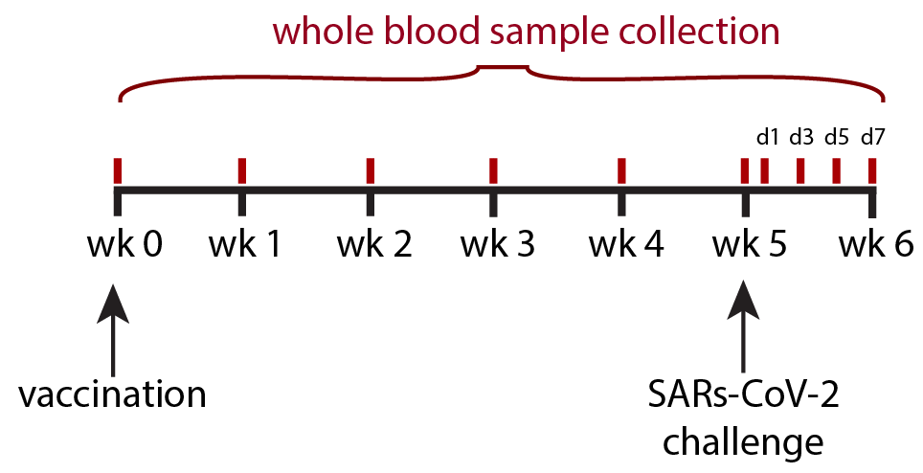
Study design
PI: David Hawman, Heinz Feldmann; Animal protocol done at Rocky Mountain Labs
Animal species: 12 male Rhesus Macaque
Animal groups:
1 group received RNA vaccine for SARS CoV -2 (6 animals: #308 - #313)
1 group receive RNA vaccine for Zika virus (6 animals: #314 - #319)
Vaccination regime: Prime only, no boost
Challenge: at week 5 after prime
Sample types: Whole blood
Time points:
BSLN
1wk, 2wk, 3wk, 4wk and 5wk (after vaccination)
1d, 3d, 5d, 7d (after challenge)

Slide 13
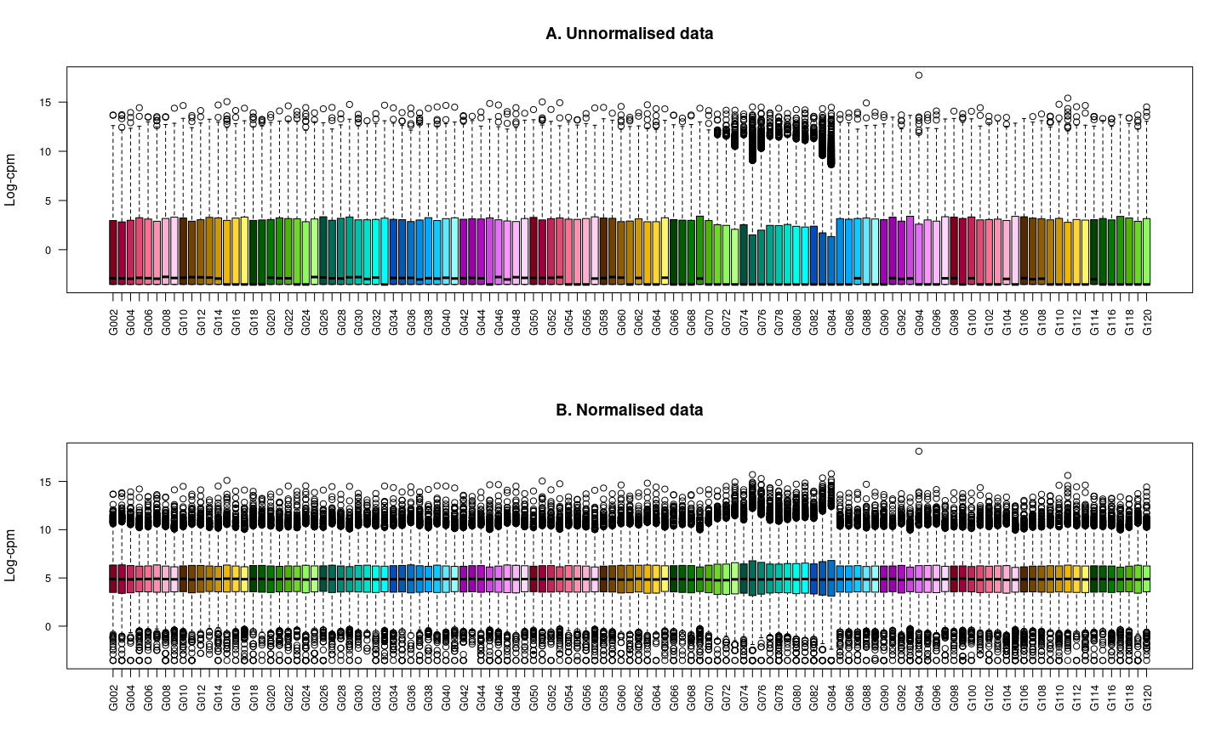
Normalizing the libraries using TMM
Extract DE genes
Libraries normalization
DPC1
(G073 - G084)
Use DINA
Samples of DPC1 timepoint have more outliers

Slide 14
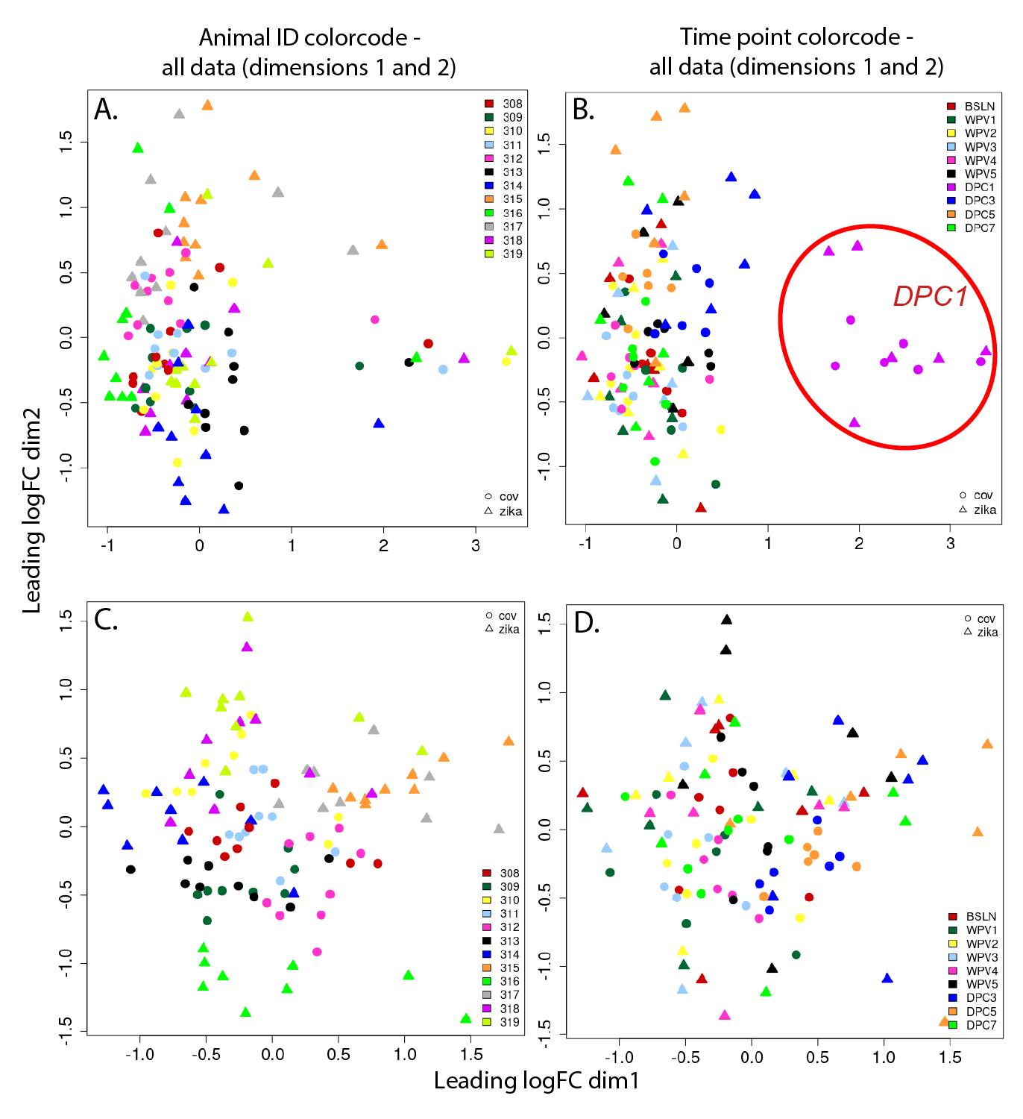
Unsupervised sample clustering shows unusual pattern
Extract DE genes
Unsupervised clustering
Use DINA
Largest variation induced by time point –
not by animalID!

Slide 15
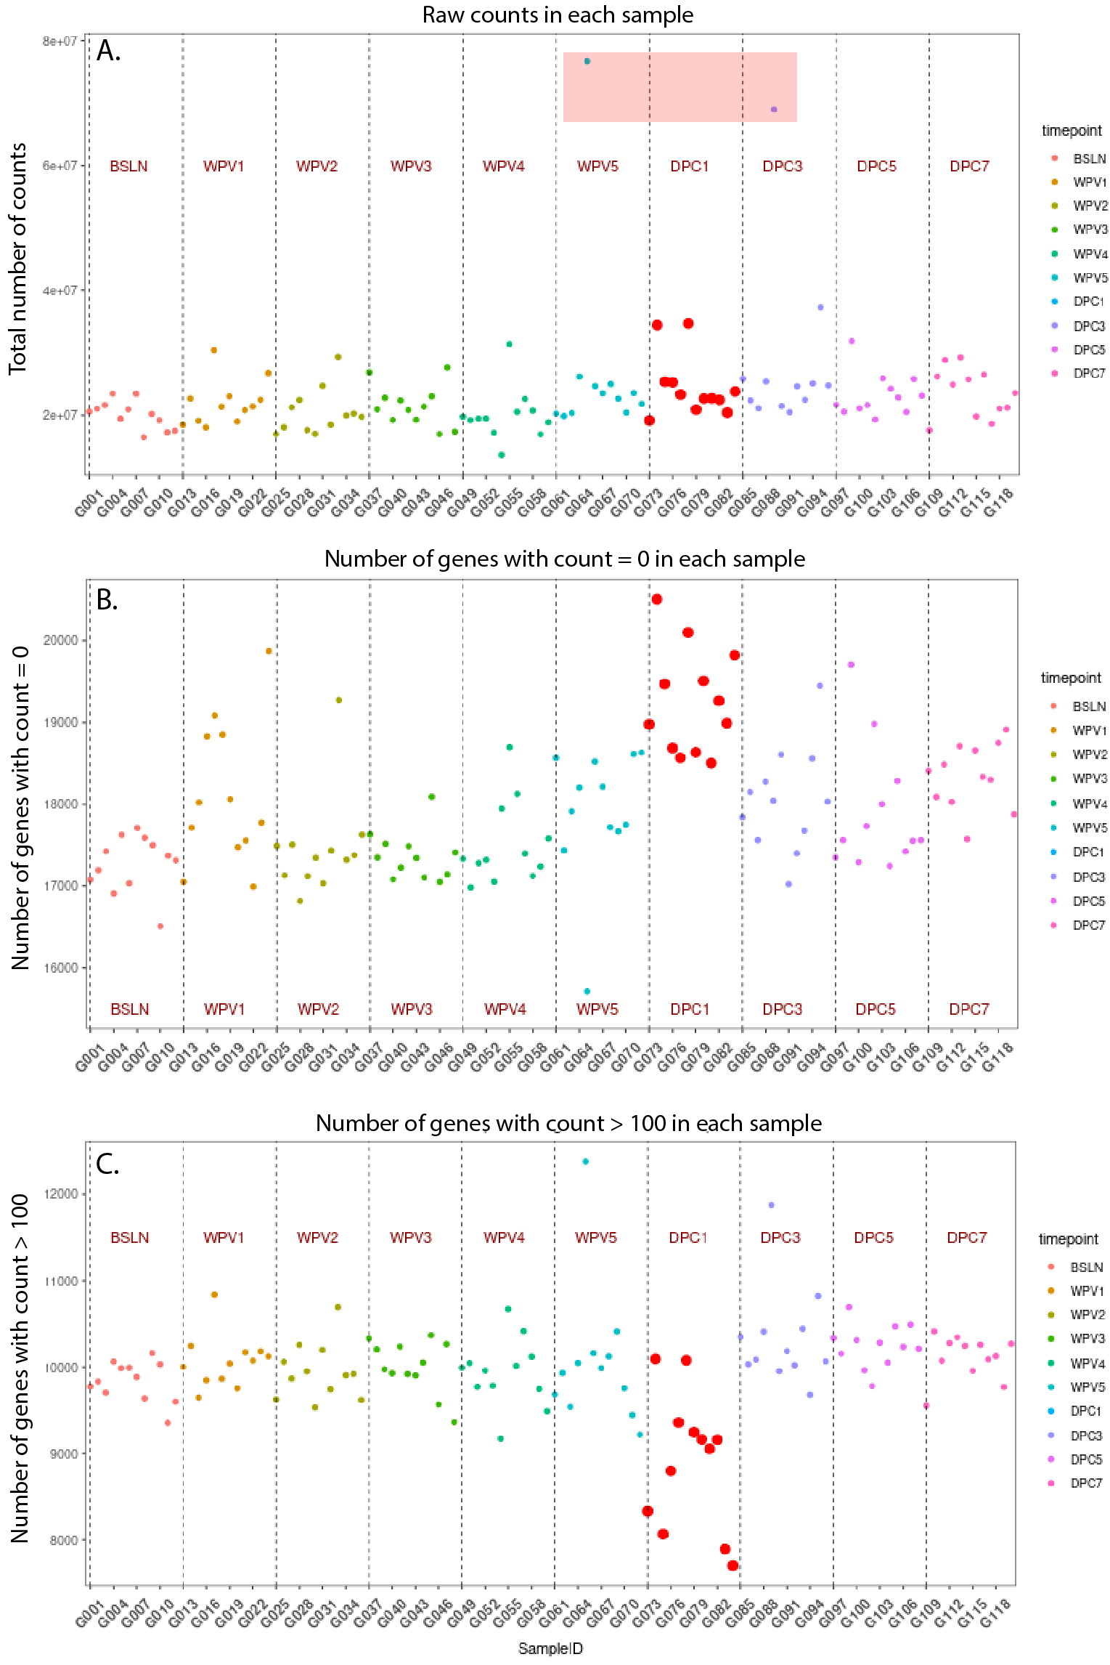
The pattern comes from libraries with more uniquely genes expressed
- DPC1 timepoint samples have similar library sizes to other samples
- DPC1 timepoint samples have fewer genes expressed but at higher counts

Slide 16
Calculating DE genes for each contrast
gr <- cond & tp
design the matrix (~0+gr+mk)
choose the comparisons
Extract DE genes
Create model to extract DE genes
get weights for each gene and sample
Use DINA
fit linear model
estimate contrast for each gene
Bayesian smoothing

Slide 17
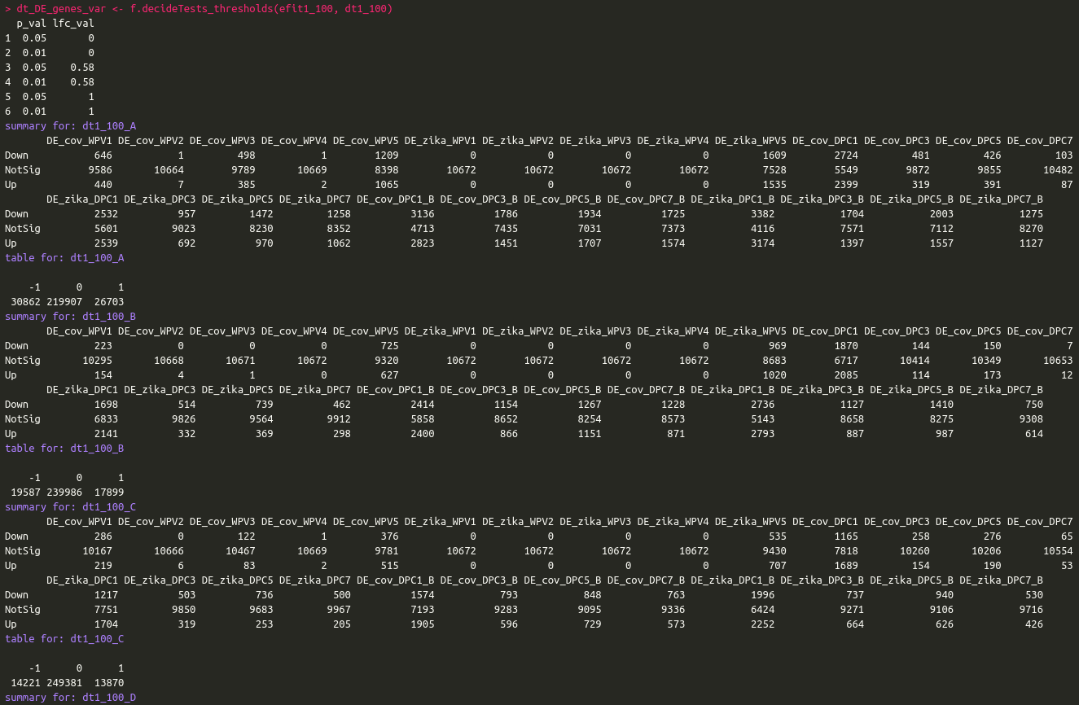
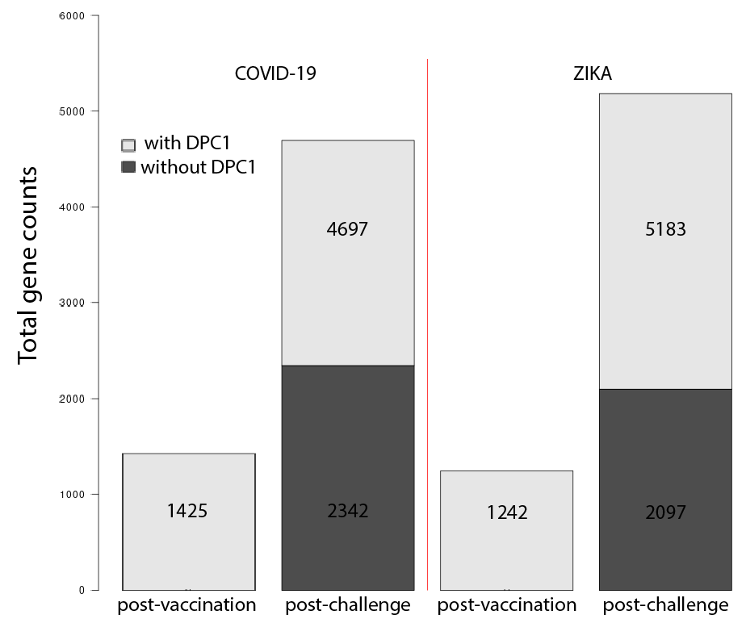
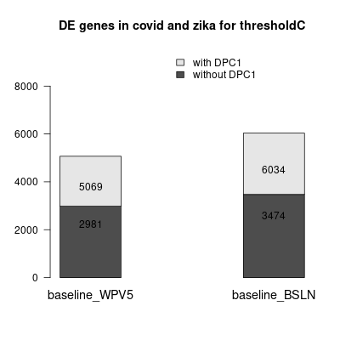
Calculating DE genes for each contrast
Extract DE genes
Create model to extract DE genes
Use DINA
615 - unique genes for WPV1 - WPV4

Slide 18
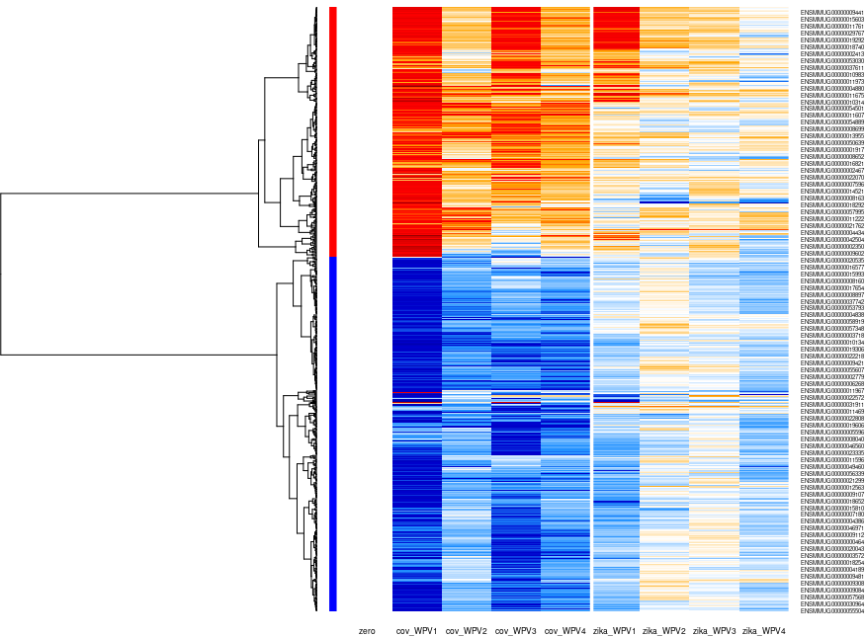
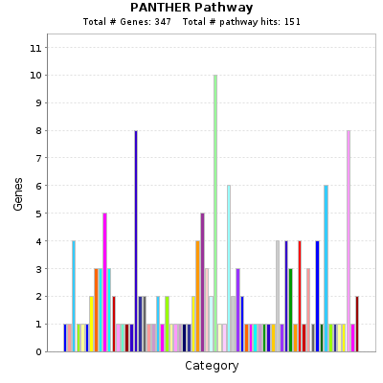
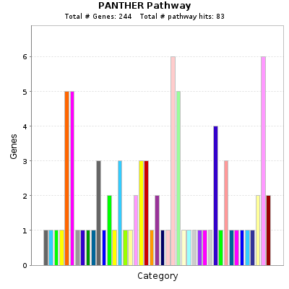
Gene clustering pools the genes in 2 distinct groups
= GO term enrichment =
(baseline: tp0, only WPV1 - WPV4)
Pathway enrichment in PANTHER
1. Inflammation mediated by chemokine and cytokine signaling pathway (P00031)
2. CCKR signaling map (P06959)
-Wnt signaling pathway (P00057)
3. Integrin signalling pathway (P00034)
- Toll receptor signaling pathway (P00054)
615 genes
1. Huntington disease (P00029)
-Wnt signaling pathway (P00057)
2. Angiogenesis (P00005)
-Apoptosis signaling pathway (P00006)
-Inflammation mediated by chemokine and cytokine signaling pathway (P00031)
3. PDGF signaling pathway (P00047)
4. ...T cell activation(P00053)
Extract DE genes
Clustering the samples
Use DINA

Slide 19
Gene clustering pools the genes in 2 distinct groups
= GO term enrichment =
(baseline: tp0, only WPV1 - WPV4)
Enrichment in DAVID
615 genes
1. innate immunity and inflammatory response (CD14, LST1, TLR1/2/4/8)
2. immunity (CD14, LST1, TLR1/2/4/8)
1. defense response to virus (OAS1/2/L, DDX60, MX1, IFIT1/3/5, TLR3)
2. immune response (OAS1/2/L, CD244, CCL23)
3. negative regulation of viral genome replication (OAS1/L, MX1, IFIT1, RSAD2)
-cell migration (RASGEF1A, PTK7, SDC3)
4. T cell receptor signaling pathway
Extract DE genes
Clustering the samples
Use DINA

Slide 20
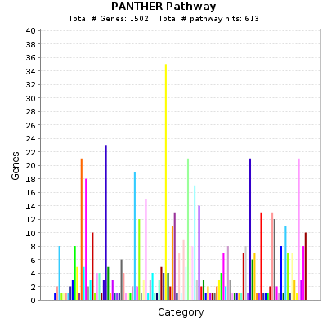
GO term enrichment for week 5 after vaccination
= the top most enriched pathways are generic =
(baseline: tp0, only WPV5)
Enrichment in Panther
The most enriched pathways:
1. Gonadotropin-releasing hormone receptor pathway (P06664)
2. CCKR signaling map (P06959)
3. Angiogenesis (P00005)
- Inflammation mediated by chemokine and cytokine signaling pathway (P00031)
- PDGF signaling pathway (P00047)
- Wnt signaling pathway (P00057)
Extract DE genes
Clustering the samples
Use DINA

Slide 21
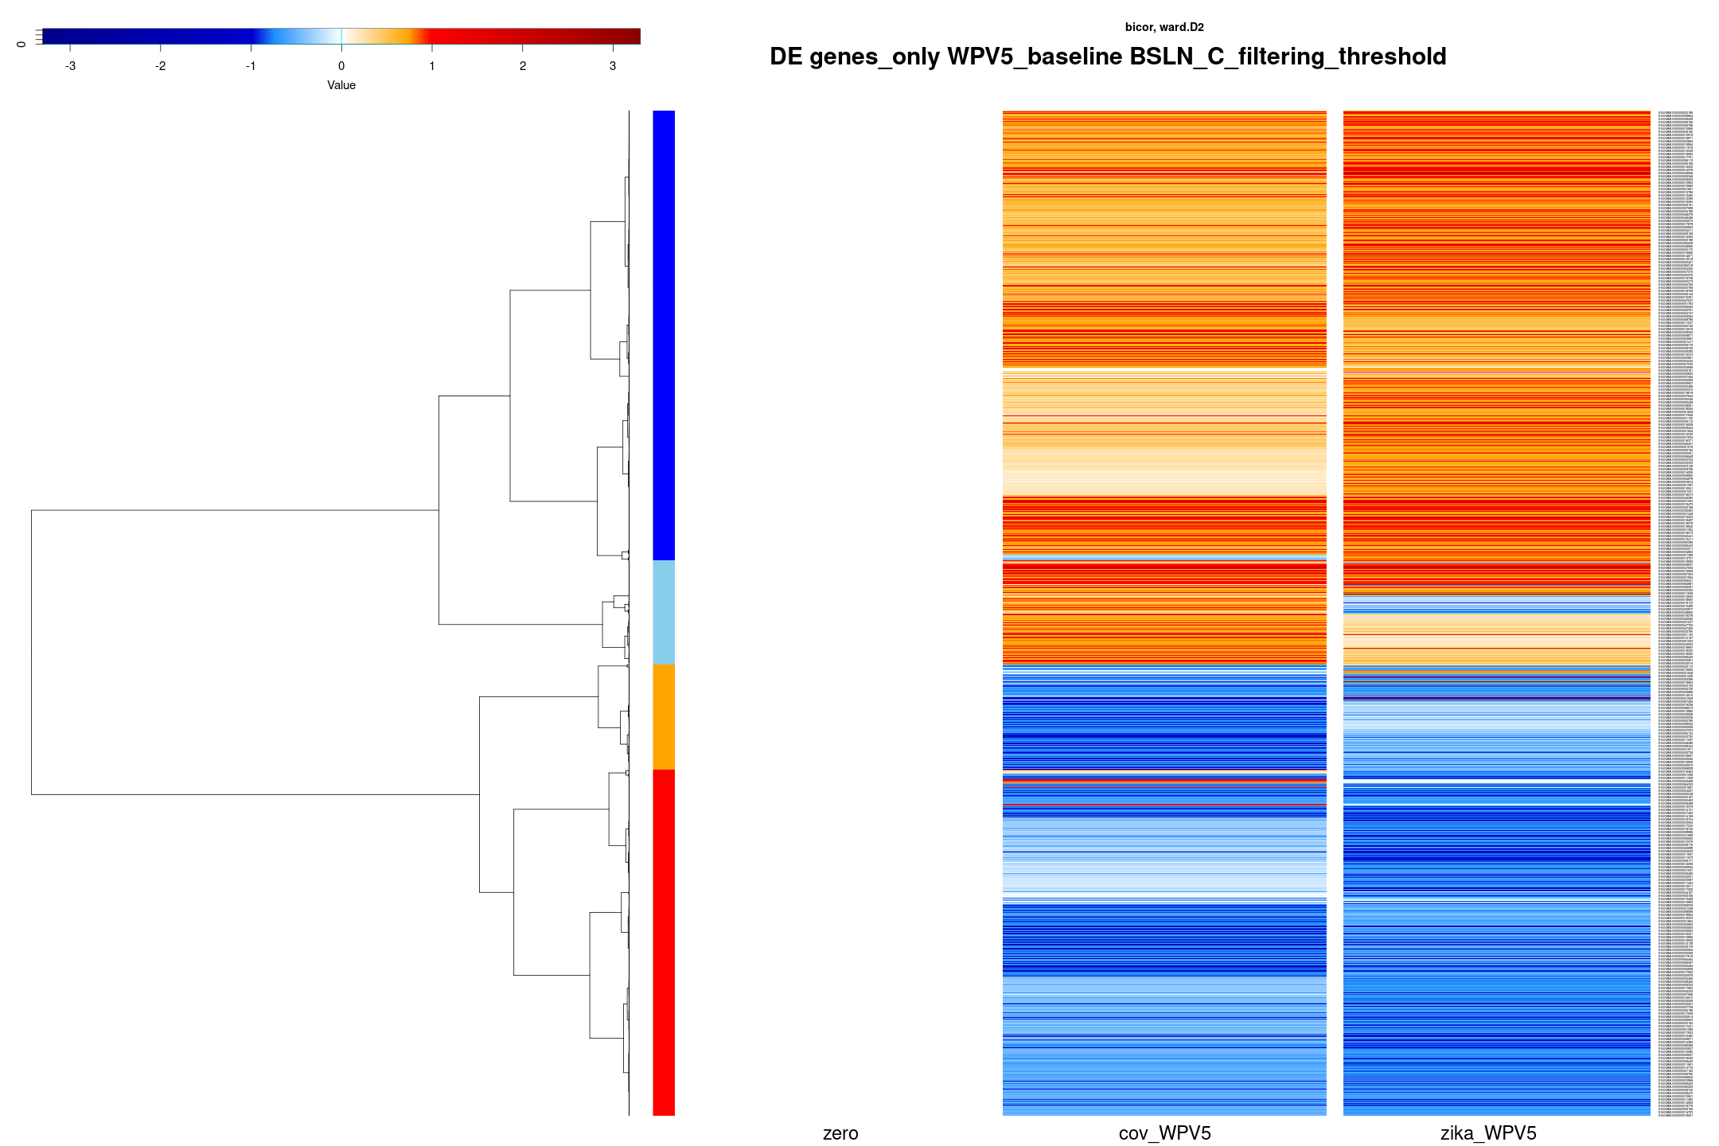
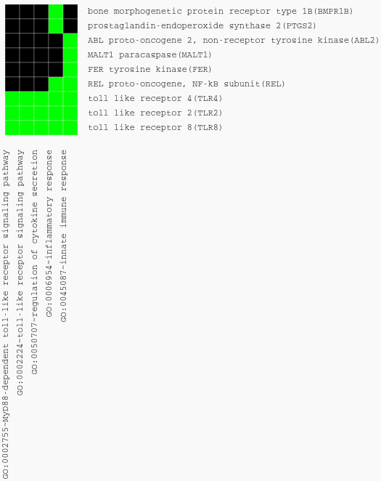
GO term enrichment for week 5 after vaccination
(baseline: tp0, only WPV5)
Enrichment in DAVID
Cluster1
1. regulation of cytokine secretion
2. MyD88-dependent toll-like receptor signaling pathway
3. toll-like receptor signaling pathway
4. innate immune response
5. inflammatory response
Cluster2
1. negative regulation of chronic inflammatory response (FOXP3)
2. developmental process involved in reproduction
3. protein ubiquitination
4. positive regulation of cellular protein catabolic process
5. nervous system development
6. regulation of neuron differentiation
Extract DE genes
Clustering the samples
Use DINA

Slide 22
GO for week 5 after vaccination
(baseline: tp0, only WPV5)
I have done the clustering to see if I can tease out some cluster of genes that has specific immunological functions in WPV5.
Those genes are mostly in cluster1.
Enrichment in DAVID
Cluster3
1. cellular response to oxidative stress
2. hexose transmembrane transport
3. glucose import
4. cell motility
5. spinal cord motor neuron differentiation
6. cholesterol efflux
7. neuromuscular synaptic transmission
Cluster4
1. centrosome organization
2. bone development
3. oocyte maturation
4. detection of mechanical stimulus involved in sensory perception of sound
5. eosinophil fate commitment (GATA1/2)
6. positive regulation of angiogenesis
7. integrin-mediated signaling pathway
8. regulation of primitive erythrocyte differentiation
9. protein monoubiquitination
10. negative regulation of cytokine-mediated signaling pathway
Extract DE genes
Clustering the samples
Use DINA

Slide 23
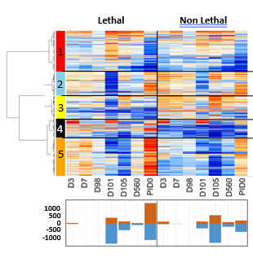
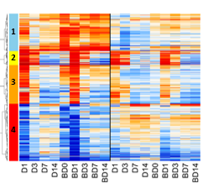
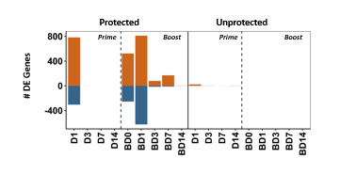
RhCMV/TB
CyCMV/SIV
Just prior to infection
Just prior to Boost
Dan Newhouse, Gale lab

Slide 24
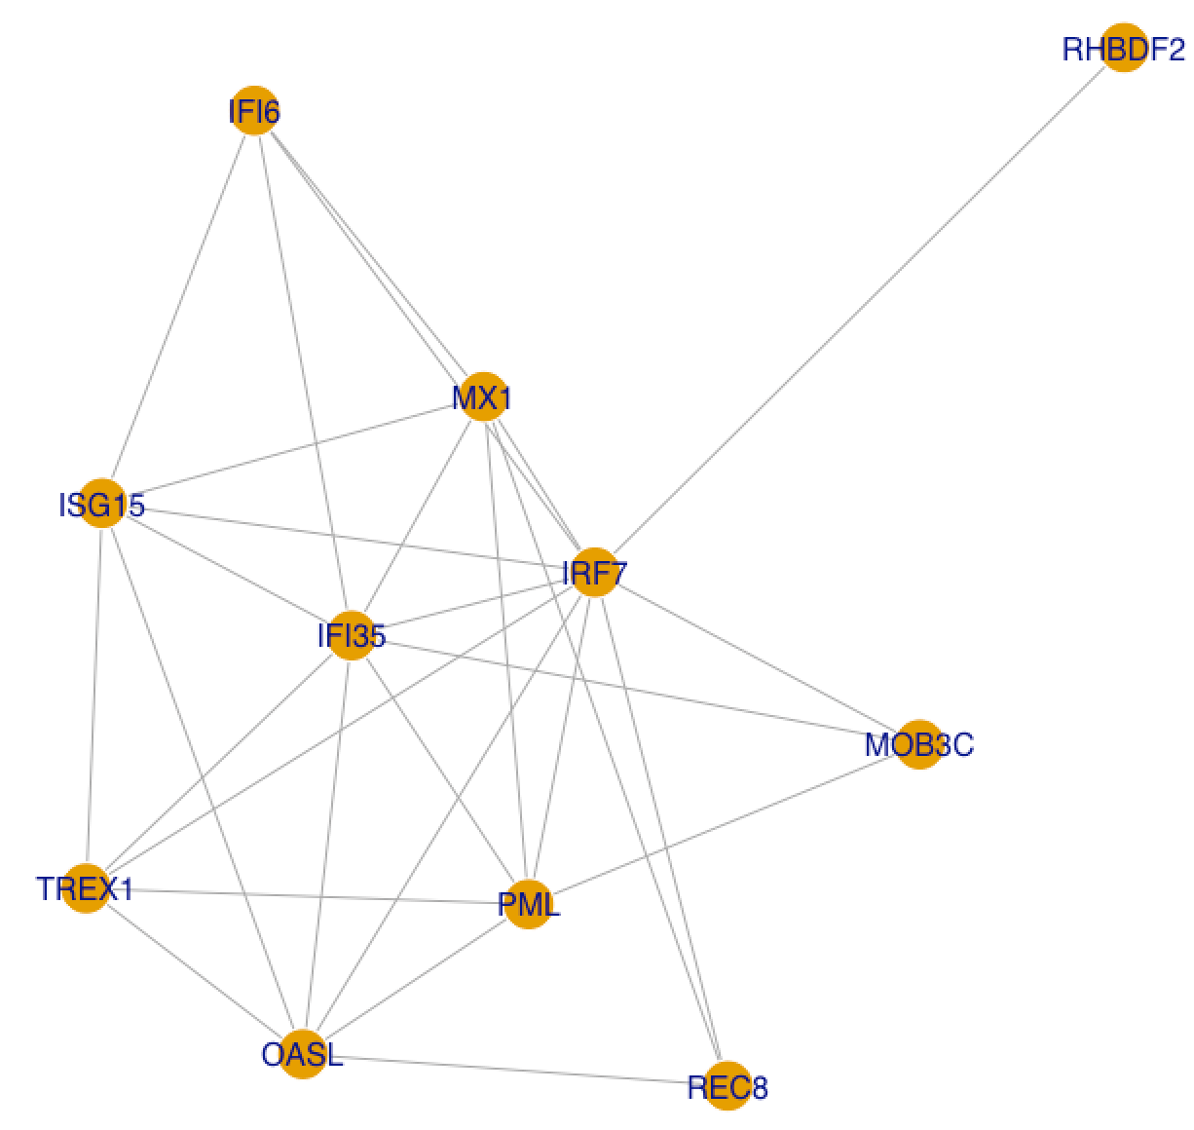
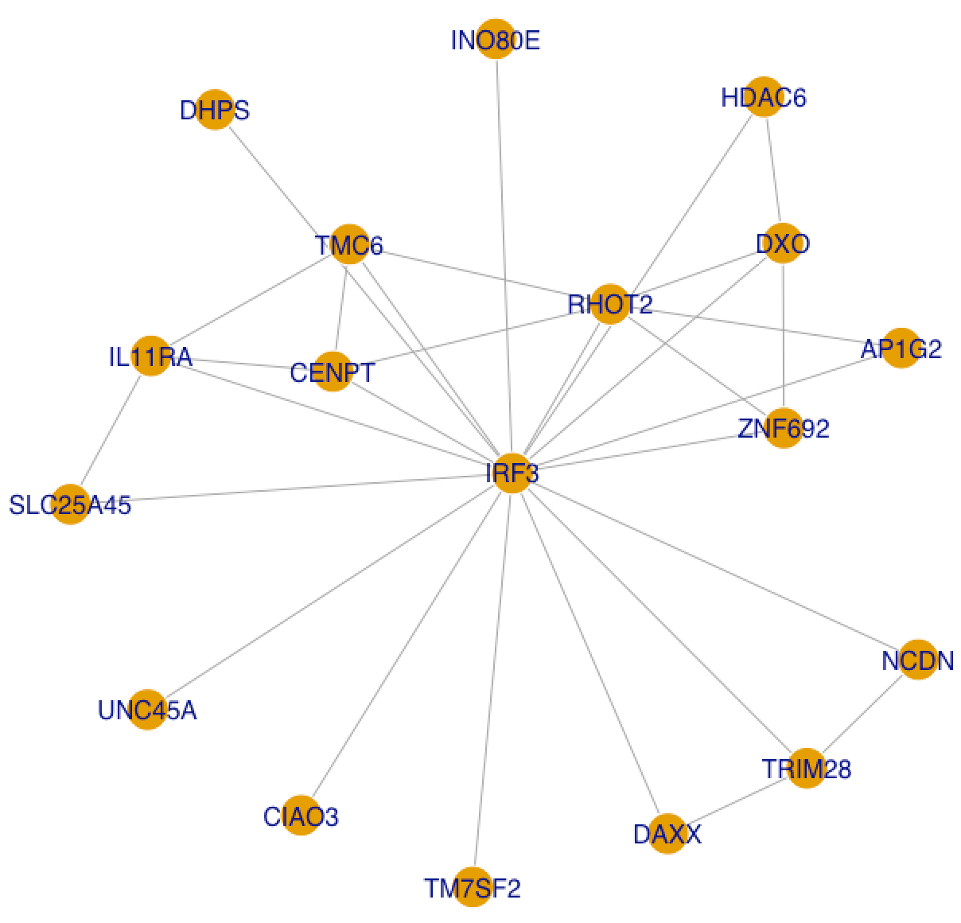
1st degree neighborhood of
IRF3 and IRF7 in DINA
Genes that are found differentially expressed in:
WPV1_4
WPV5

Slide 25
2nd degree neighborhood of
IRF3 and IRF7 in DINA – too many
IRF3: 388 genes, including IL11RA, IL2RB
IRF7: 117 genes, including:
* IFI27, IFI35, IFI44, IFI44L, IFI6, IFIT1, IFIT3, IFITM1, IFITM3,
* IL15RA, IL20RB, IRF9,
* ISG15, ISG20, MX1, MX2, OAS1, OAS2, OAS3, OASL, STAT2

Slide 26
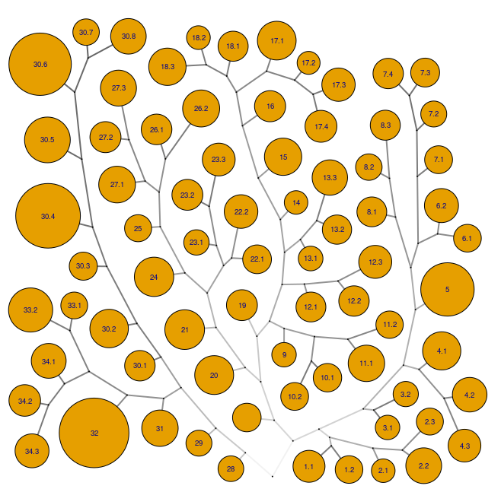
DINA – tree-and-leaf graphical overview
ID gene modules with strong statistic support
Use gene expression signatures >
Assign biological function to each module
23.1
GO:2000391 positive regulation of neutrophil extravasation
GO:0072683 T cell extravasation
GO:0034109 homotypic cell-cell adhesion
26.2
GO:0003408 optic cup formation involved in camera-type eye development
GO:0090403 oxidative stress-induced premature senescence
GO:0090399 replicative senescence
GO:0060317 cardiac epithelial to mesenchymal transition
GO:0043616 keratinocyte proliferation
GO:0014068 positive regulation of phosphatidylinositol 3-kinase signaling
GO:0046849 bone remodelling
GO:0046330 positive regulation of JNK cascade
31
GO:2001199 negative regulation of dendritic cell differentiation
23.3
GO:2000391 positive regulation of neutrophil extravasation
GO:0072683 T cell extravasation
GO:0034109 homotypic cell-cell adhesion

Slide 27
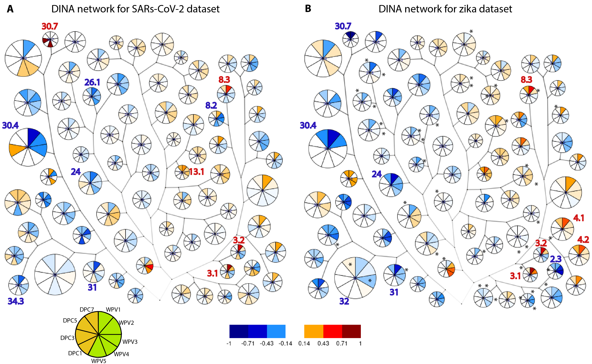
The differences in gene signatures between SARs-CoV-2 and zika

Slide 28
The differences in gene signatures between SARs-CoV-2 and zika
Upregulated modules
SARs-CoV-2
3.1 and 3.2 - cellular biosynthetic processes: macromolecule modification, lipoproteic metabolism
8.3 - modulation by symbiont of entry into host, carbohydrate metabolic process
13.1 - RNA metabolic processing
Upregulated modules
zika
3.1 and 3.2 - cellular biosynthetic processes: macromolecule modification, lipoproteic metabolism
8.3 - modulation by symbiont of entry into host, carbohydrate metabolic process
4.1 - neuron differentiation

Slide 29
Downregulated modules
SARs-CoV-2
31 - regulation of leukocyte and DC differentiation
34.3 - bone, skin and skeletal muscle development, cell differentiation - cellular hormone metabolic, lipid catabolic process, negative regulation of cells, response to nutrient/ extracellular stimulus (vit A) - T cell differentiation and activation - fluid homeostasis - cellular responses to chemicals
26.1 - eye, heart, epithelium development - cellular response to stress, cell aging - tissue remodeling - positive regulation of cell , cell signaling
8.2 - movement in host environment - carbohydrate metabolic process
The differences in gene signatures between SARs-CoV-2 and zika
Downregulated modules
zika
32 - lysosomal transport, protein transport, export from the cell
2.3 - connective tissue, epithelium development - reduction in angiogenesis, endothelial cell differentiation and reduction in proliferation response to growth factors
24 - macromolecule biosynthetic processes
31 - regulation of leukocyte and dendritic cell differentiation

Slide 30
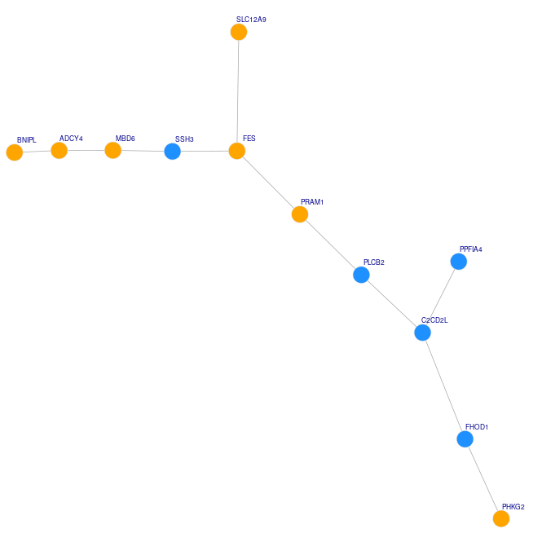
Gene signature for SARs-CoV-2 priming
BNIPL – cell proliferation/ cell death (BCL2)
ADCY4 – formation of cAMP in response to GPCR signaling
MBD6 – prot deubiquitination (mut. in autism)
SSH3 – actin dynamics
FES – normal hematopoiesis, GF and cytokine receptor signaling (mut. in APL); acts on BCL2
- mast cell degranulation (granulocyte: defense against pathogens esp. in intestine and airways; allergies)
SLC12A9 – cation chloride symporter activity
PRAM1 – adapter protein in TCR mediated signaling; induced by RA
PLCB2 – intracellular signaling
C2CD2L – insulin binding
PPFIA4 -disassembly of focal adhesions
FHOD1 – actin binding; assembly of stress fibers
PHKG2 – energy metabolism
- DE genes after vaccination for each time point > no DE genes for zika > can’t be done
- unique genes expressed only in WPV5_cov and not in WPV5_zika
- network formed from all the DE genes at WPV5

Slide 31
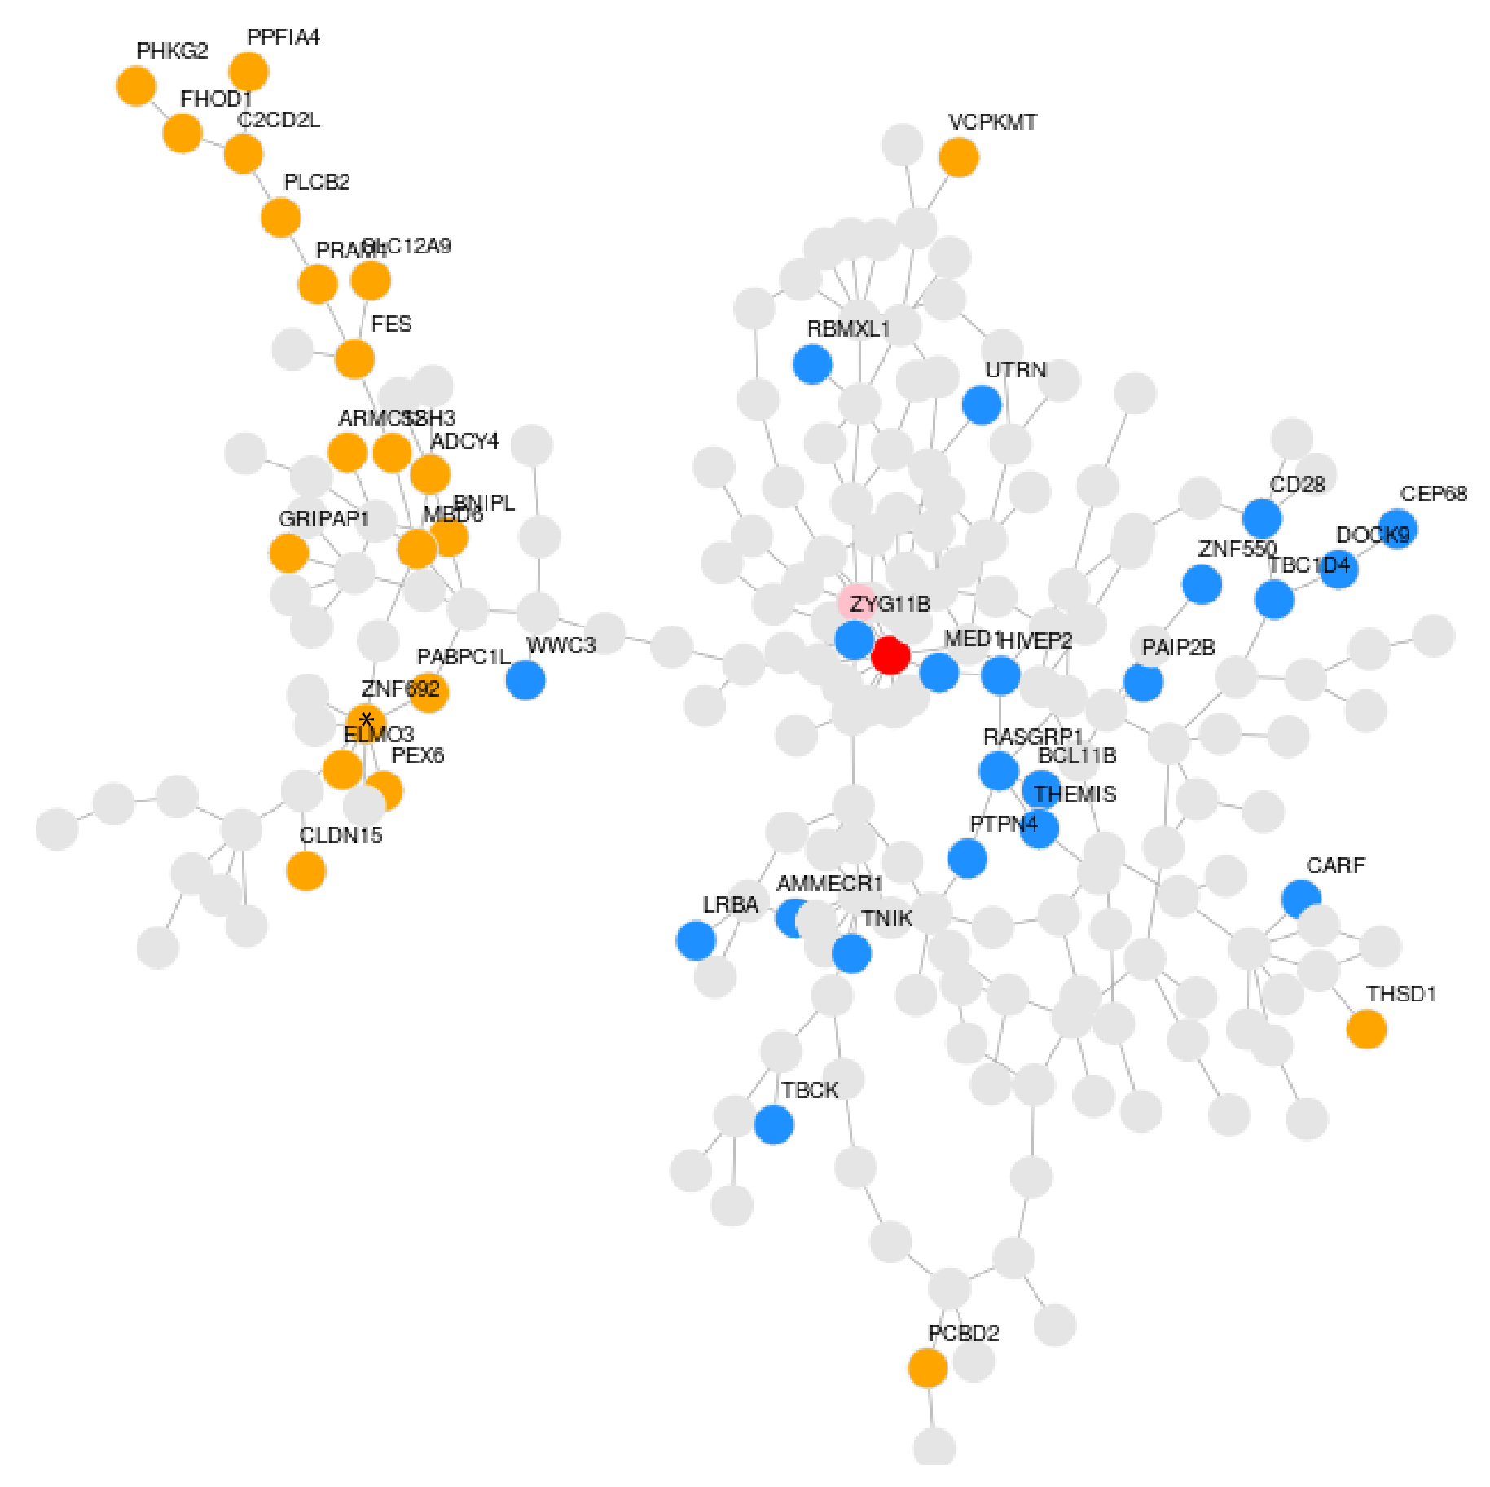
Gene signature for SARs-CoV-2 priming
CEP350
- 15 connections
- microtubule anchoring protein essential for the integrity of the microtubule network
TAOK1
- 9 vertices
- mutation in lung adenocarcinoma; activates MAP2K3/6; disregulated in inflammatory and immune disorders
ZNF692
- 8 vertices
- zinc finger protein; in lung adenocarcinoma where it promotes cell proliferation and motility
- unique genes expressed only in WPV5_cov and not in WPV5_zika
- network formed from all the DE genes

Slide 32
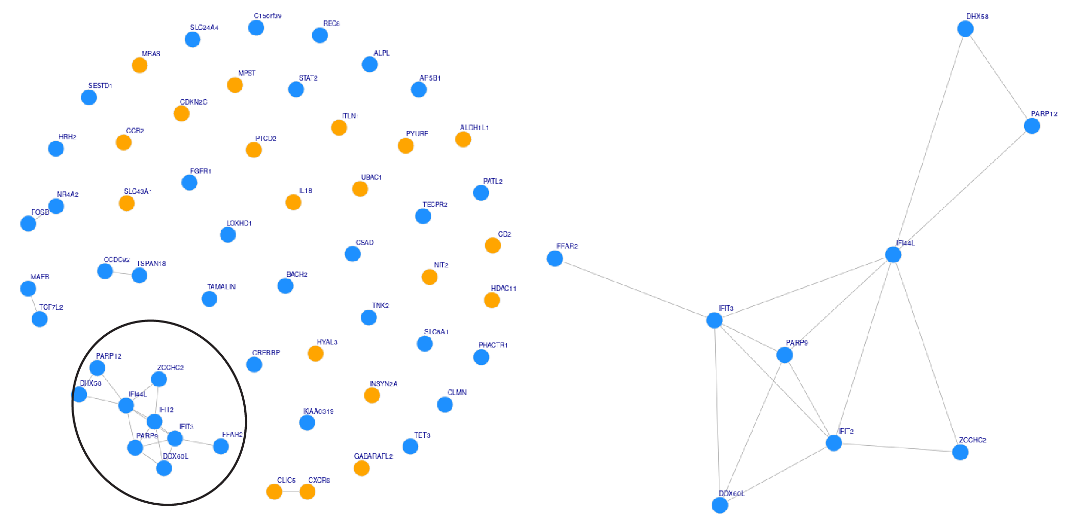
Gene signature for SARs-CoV-2 protection
IFI44L
- defense response of the body to viruses and is a type I INF-related gene
IFIT2 and IFIT3
- paralogs,; involved in INF-gamma signaling, active in innate immune responses. IFIT2 has a positive regulatory effect in programmed cell death
PARP9
- in INF-mediated antiviral response
PARP12
- in inflammatory responses via association with NF-kB signaling
DHX58
- active in the innate immune system, helping to mount an attack against the viruses through interacting directly with RIG-I
DDX60L
- INF stimulated gene that can bind to viral particles in the cytosol, alerting the cell to the presence of an intruder
FFAR2
- involved in mucosal immunity
- DE genes after challenge for each time point > too dense networks to give a result
- unique genes expressed only in DPC7_cov and not in DPC7_zika
- network formed from all the DE genes at DPC7

Slide 33
Conclusions
- DINA gives a cleaner overview of the tendencies of gene gene-gene interactions
- SARs-CoV-2 priming signature seems unspecific > vaccine?
- SARs-CoV-2 protection signature is specific and made of a relatively large network

Slide 34
